Slide 1

Hospital Equipment and Comfort Devices
CR 12.3

Slide 2
Learning outcomes
1. Knowing about various equipment and devices used in patient care
2. Knowing about comfort devices and their purpose for patient care
3. Taking care and maintenance of different kinds of equipment
1

Slide 3
Introduction
Introduction
Usage of disposable and high-tech items in healthcare for various diagnostic and therapeutic procedures are becoming common today
These items are generally classifies by their use, different makes and materials used like; synthetic rubber, glass, stainless steel, etc.
Quality of care, as such, largely depends on the caregiver’s ability to use these items efficiently depending on the experience and knowledge
The correct method of usage of these items requires knowledge for the safety of the patients, as well
A caregiver must apply his/her knowledge for safe use of these equipment and supplies with necessary due care for an individual patient
2

Slide 4
Types of Equipment used (1/6)
Learning outcomes
Classification based on material used*:
Rubber Items - Mackintosh, Gloves, Rubber tubes, Hot water bag, Mouthpiece, Ambu bag, etc.
Glass Items - Ounce glass, Syringes, Test tubes, Jars, Thermometer, etc.
Enamel items - Trays, Kidney trays, Basins, Bowls, Jars, Enema can, Bed pan, Urinals, etc.
Stainless Steel items - Various Forceps, Different needles, Scopes, Sharp instruments like surgical blades, Scissors,
Fibre-Optics - Lenses in Camera and in various diagnostic equipment
* This classification often gets blurred due to usage of alternative materials by the manufacturers.
3

Slide 5
Types of Equipment used (2/6)
Learning outcomes
Rubber Items
Mackintosh
Rubber Tube
Rubber Tube
Ice-Cap
Hot Water Bottle
Ice Collar
Air Cushion
Gloves
Mouthpiece
Pillows
Air/Water Mattress
4

Slide 6
Types of Equipment used (3/6)
Learning outcomes
Glass Items
Syringes
Test Tube
Conical Funnel
Thermometer
Undine for Eye Irrigation
Intra-venous Fluid Bottles
5

Slide 7
Types of Equipment used (4/6)
Learning outcomes
Enamel Items
Tray
Basins
Bowls
Pint Measure
Jugs
Urinals
Sputum Mugs
Bed Pan
Enema Can
Buckets
Bin Tray
6

Slide 8
Types of Equipment used (5/6)
Learning outcomes
Stainless Steel Items
Forceps and Holders
Speculum
Needles for Different Types Injections
Needles for Stitching
Procto-Scope
Sharp Surgical Instruments
Different Types of Forceps
Other Surgical Instruments
7

Slide 9
Types of Equipment used (6/6)
Learning outcomes
Fibre-Optics
Gastro Scope
Endoscope
Laparoscope
Anthroscope
Bronchoscope
8

Slide 10
Care and Maintenance of Equipment (1/2)
Learning outcomes
Purpose of care and maintenance of equipment used:
To prevent spread of infection
To clean the articles & prepare for reuse.
To remove stains
To preserve life of articles
General principles of care and maintenance of articles:
Wash all the articles thoroughly with soap and water, rinse them well, decontaminate and replace at the appropriate place
Do not use hot water to clean rubber articles as they get destroyed with heat
Always dry rubber goods them in shade as heat will destroy them
9

Slide 11
Care and Maintenance of Equipment (2/2)
Learning outcomes
General principles of care and maintenance of articles:
All fibre-optic scopes are expensive items and require careful handling
They are used in diagnostic labs
They are flexible and get damaged by heat
Detach camera from the scope
Remove obturator from the scope using a gauze pad soaked in 2% Glutaraldehyde to disinfect
Hang the scope and obturator before replacing in the cupboard or container
Replace the lens cover of the camera and put it in its container to avoid damage
10

Slide 12
Comfort Devices
What is a comfort device:
Comfort is the absence of irritating stimuli that distracts one's attention from the task at hand.
Comfort devices are the mechanical devices designed to provide optimal comfort to an individual.
11

Slide 13
Some Comfort Devices (1/10)
Pillows
Back rest
Bed cradle
Cardiac table
Mattress
Footboard
Sandbags
Trochanter Rolls
Side rails
Wedge/Abductor pillow
Knee rest
Bed blocks
Air cushion
Rubber & cotton rings
Hand rolls
12

Slide 14

Some Comfort Devices (2/10)
Pillows
Purpose:
Used for support to maintain correct body alignment
Used under head, arms, legs and along spine or abdomen to provide comfort
Support patient’s back at an angle, to maintain in a sitting position
Could be adjusted to desired angle, may be with extra pillows
Arms of patient are well supported
Used for patients suffering with cardiac and pulmonary distress
13

Slide 15
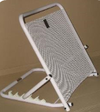
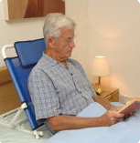
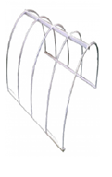
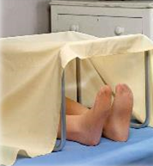
Some Comfort Devices (3/10)
Back Rest
Purpose:
To relieve dyspnea
To promote drainage from abdominal cavity
To provide a comfortable position
Bed Cradle
It is a frame a semicircular or rectangular frame of metal or made of wood or bamboo used to hold the bed linen from touching a particular part of body.
Purpose:
To prevent pressure from the weight of linen
To allow air to circulate around lower limbs
14

Slide 16
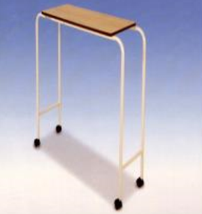
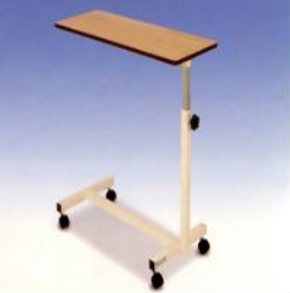
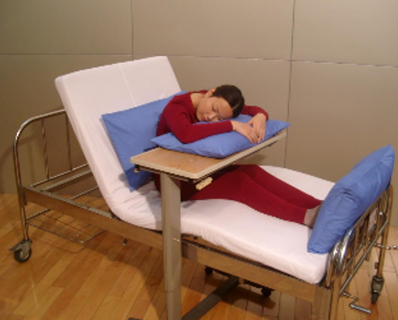
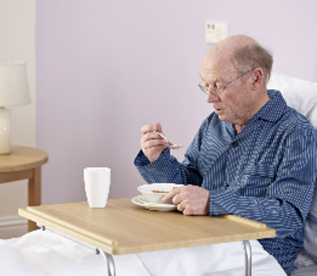
Some Comfort Devices (4/10)
Cardiac Table
Purpose:
Bed table placed in front with a pillow on it, patient can lean forward and take rest
Table without pillow is used for writing or for having meals
Used for patients with cardiac conditions and asthma
Position should be changed to relieve fatigue
Patient can rest over the table with the help of pillow
Easy to have meals
Can be used for writing or reading
15

Slide 17
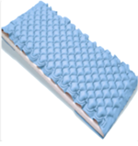
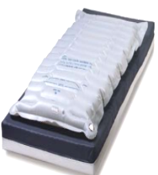
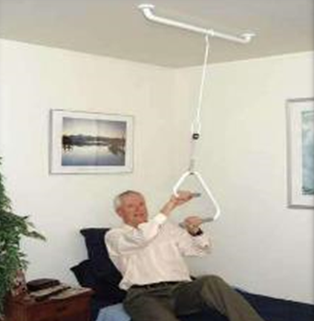
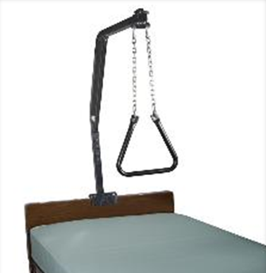
Some Comfort Devices (5/10)
Mattress
Mainly two types:
1. Air mattress 2. Water mattress
Purpose:
To provide comfort
Used for very thin or very obese patients, and those who are prone to pressure sores
Trapeze Bar
It is a bar suspended from the
overhead frame to head of the bed.
Purpose:
Patient can grasp the bar to raise the trunk off the bed surface or to move up in the bed
16

Slide 18
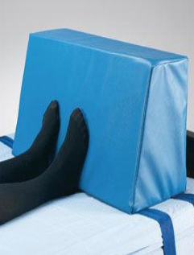
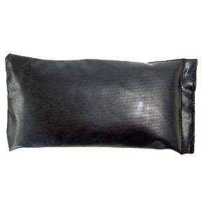
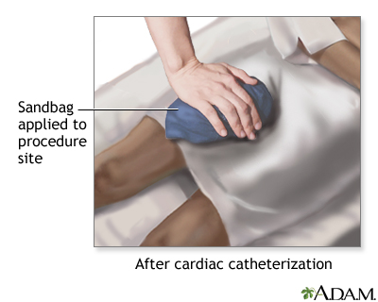
Some Comfort Devices (6/10)
Footboard
Device that is placed towards the foot of pts bed to serve as support for his feet
Usually made up of wood/plastic/heavy canvas
Purpose:
To support patient’s feet
To prevent foot drop
Sandbags
They are sand filled plastic bags that can be shaped to body contours
Can be used in place of or in addition to trochanter rolls
Purpose:
Provide support and shape to body
Immobilize extremities and maintain specific body alignment
17

Slide 19
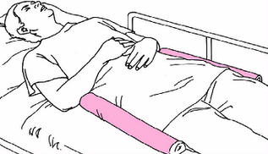
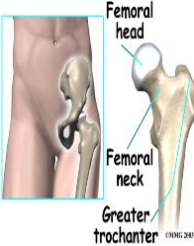
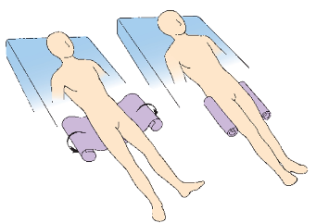
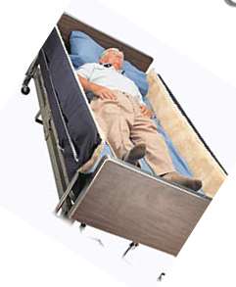
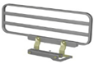
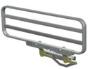
Some Comfort Devices (7/10)
Trochanter Rolls
A cotton bath blanket/sheet is folded lengthwise to width extending from greater trochanter of femur to lower border of popliteal space
Purpose:
Prevent external rotation of legs when patient is in supine position
Side Rails
Side rails are the bars positioned along the sides of the length of the bed
Purpose:
Ensure patient’s safety, and are useful for increasing mobility
Provide assistance in rolling from side to side or sitting up in bed
18

Slide 20
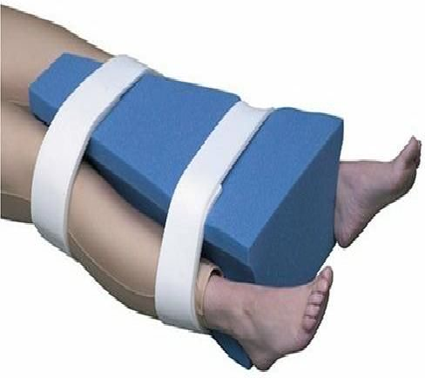
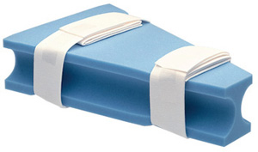
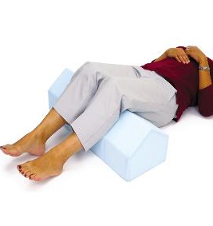
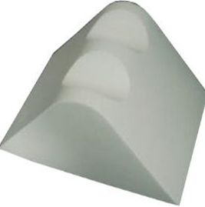
Some Comfort Devices (8/10)
Wedge /Abductor Pillow
It is a triangular shaped pillow made of heavy foam
Purpose:
Used to maintain legs in abduction following Total Hip Replacement Surgery
Knee Rest
This is a device placed under the knees to provide comfort
Purpose:
Gives relaxation and thus relieves pain on tendons beneath the knees
19

Slide 21
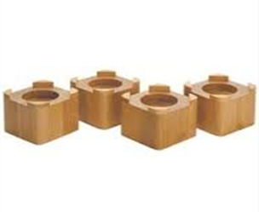
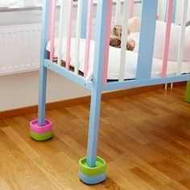
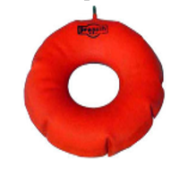
Some Comfort Devices (9/10)
Bed Blocks
Made up of wood or metal
Purpose:
Used to raise the foot end or head end of the bed
Air Cushion
Air cushions are made up of rubber, and it can be inflated with air
Purpose:
Used to take off the weight of the body and to relieve pressure on certain parts of the body
20

Slide 22
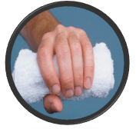
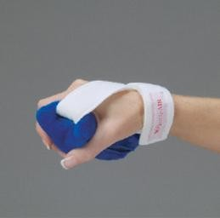
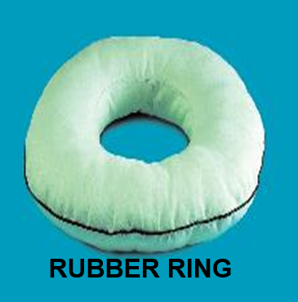
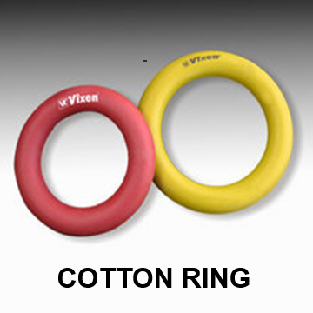
Some Comfort Devices (10/10)
Hand Rolls
Made by folding a washcloth in half, rolling in lengthwise and securing roll with tape, and is placed against palmar surface of hand
Purpose:
Maintain thumb in slightly adducted and in opposition to fingers
Maintain fingers in slightly flexed position
Rubber and Cotton Rings
These are circular rings made of rubber or cotton
Purpose:
These are used to relieve pressure on certain parts of the body like elbow and heels
21

Slide 23


Slide 24
Viewing of Modules
Assistive Devices for the Elder
CR 12.3
Private and Confidential

Slide 25
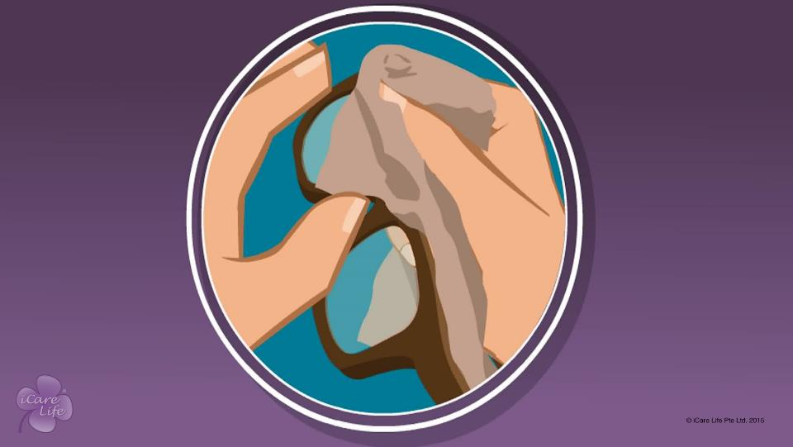
Assistive Devices for the Elder
1
Copyright: iCare Life Pte. Ltd., Singapore : This document must not be copied or shared or circulated without the consent of iCare Life and/or its affiliates.

Slide 26
In this module, you will learn about:
The importance of assistive devices for an elder
A few common assistive devices used for elderly people
The steps for maintenance of such assistive devices
2

Slide 27

Let’s Watch
Assistive Devices for the Elder
3
Copyright: iCare Life Pte. Ltd., Singapore : This document must not be copied or shared or circulated without the consent of iCare Life and/or its affiliates.

Slide 28


